Slide 1
Learning Objective
I will be able to determine the equations of tangents and normal
Success Criteria
At the end of the lesson, I will be able to:
Determine the equations of tangents and normal

Slide 2
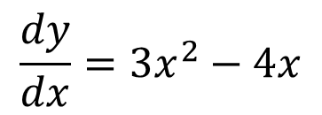
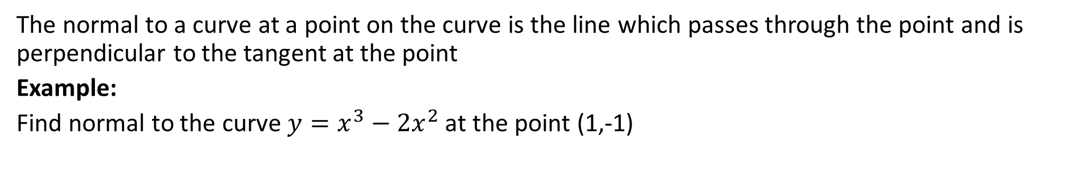
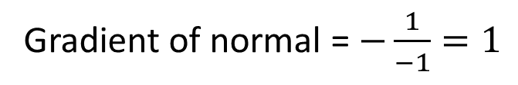

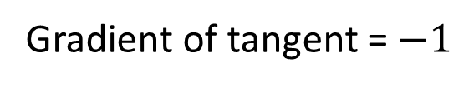
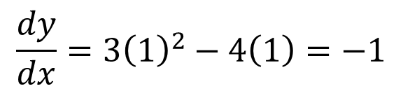

Activating Prior Knowledge
The normal to a curve at a point on the curve is the line which passes through the point and is perpendicular to the tangent at the point
Example:
Find normal to the curve $y=x^{3}−2x^{2}$ at the point (1,-1)
$$\frac{dy}{dx}=3x^{2}−4x$$
Find the gradient at point (1, -1)
$$\frac{dy}{dx}=3{\left(1\right)}^{2}−4\left(1\right)=−1$$
Gradient of tangent = $−1$
Gradient of normal = $−\frac{1}{−1}=1$
Substitute m=1, points (1,-1) into -1=(1)(1)+c
$$c=−2$$
$$y=x−2$$

Slide 3

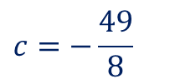
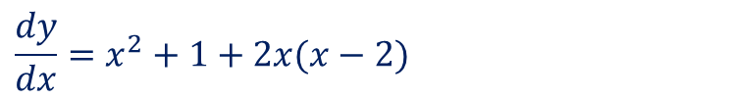
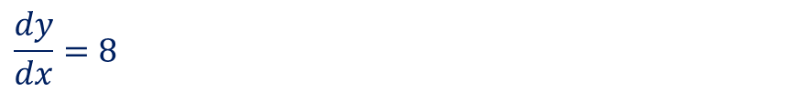
Guided Practice
Find the equations of the tangent and the normal of the graph $y=(x−2)(x^{2}+1)$ when $x=−1$
sub. $x=−1$ into $y, y=\left(−1−2\right)\left({\left(−1\right)}^{2}+1\right)$
Gradient of normal, $=−\frac{1}{8}$
$$y=−3\left(2\right)=−6$$
$$\frac{dy}{dx}=x^{2}+1+2x(x−2)$$
Equation of normal, $y=−\frac{1}{8}x+c$
$$=x^{2}+1+2x^{2}−4x$$
Sub. $\left(−1,−6\right)$into equation of normal, $−6=\frac{1}{8}+c$
$$=3x^{2}−4x+1$$
$$c=−\frac{49}{8}$$
sub. $x=−1$ into $\frac{dy}{dx}, \frac{dy}{dx}=3{\left(−1\right)}^{2}−4(−1)+1$
Equation of normal, $y=−\frac{1}{8}x−\frac{49}{8}$
$$\frac{dy}{dx}=8$$
Equation of tangent, $y=8x+c$
Sub. $\left(−1,−6\right)$into equation of tangent, $−6=−8+c$
$$c=2$$
Equation of tangent, $y=8x+2$

Slide 4
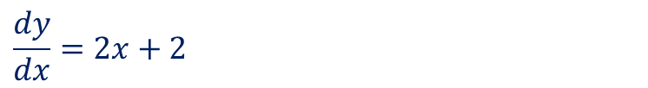



Guided Practice
The tangent to the curve with equation $y=x^{2}+2x$ at the point $(a, a^{2}+2a)$ passes through the origin. Find the value of $a$
$$\frac{dy}{dx}=2x+2$$
sub. $x=a$ into $\frac{dy}{dx}, \frac{dy}{dx}=2a+2$
Equation of tangent, $y=\left(2a+2\right)x+c$
Since it passes through the origin, $c=0$
$y=\left(2a+2\right)x$
Sub $(a,a^{2}+2a)$ into equation of tangent, $a^{2}+2a=\left(2a+2\right)a$
$a^{2}+2a=2a^{2}+2a$
$∴a^{2}=0⇒a=0$

Slide 5


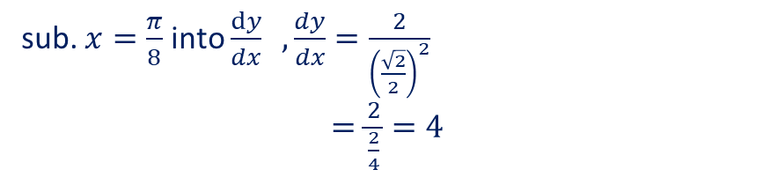

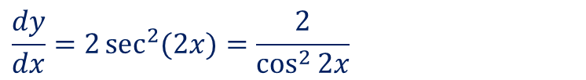
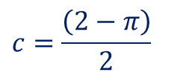
Guided Practice
The tangent to the curve with equation $y=\tan{(2x)}$at the point $x=\frac{π}{8}$ meets the y-axis at point A.
Find the distance of OA where O is the origin
sub. $x=\frac{π}{8}$ into $y , y=\tan\left(\frac{π}{4}\right)=1$
$$\frac{dy}{dx}=2\sec^{2}{(2x)}=\frac{2}{\cos^{2}{2x}}$$
sub. $x=\frac{π}{8}$ into $\frac{dy}{dx} ,\frac{dy}{dx}=\frac{2}{{\left(\frac{\sqrt{2}}{2}\right)}^{2}}$
$=\frac{2}{\frac{2}{4}}=4$
Equation of tangent, $y=4x+c$
Sub $(\frac{π}{8},1)$ into tangent, $1=4\left(\frac{π}{8}\right)+c$
$$c=1−\frac{π}{2}$$
$$c=\frac{\left(2−π\right)}{2}$$
Equation of tangent, $y=4x+\frac{\left(2−π\right)}{2}$
Distance of OA$=0−\frac{\left(2−π\right)}{2}=\frac{π−2}{2}$

Slide 6
Independent Practice
Complete Cambridge Ex 5A Except Q11 and 15

